Slide 1




www.dsts.unifi.it
www.economia.unifi.it
MASTER PROGRAM
Design of Sustainable Tourism Systems
(Classe di laurea LM-49)
Prof. Laura Grassini laura.grassini@unifi.it

Slide 2
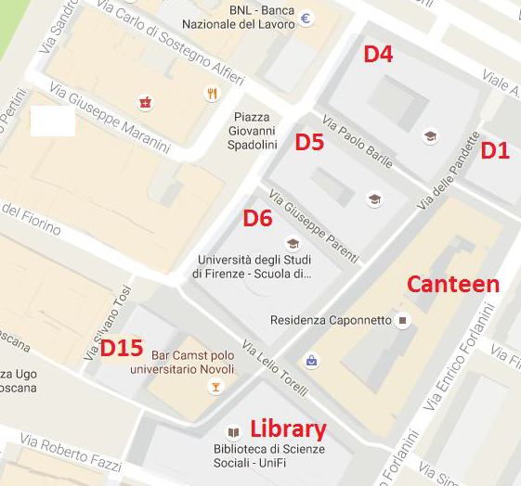
POLO DI NOVOLI
The School of Economics and Management is at Polo di Novoli (Social sciences)
Via delle Pandette 32, Firenze
Office: D1, 1st floor
CLASSROOMS
D4, D5, D6, D15
Foreign students office, International relations, Labs: D15
STUDY ROOMS D14
Students adm office
D14

Slide 3
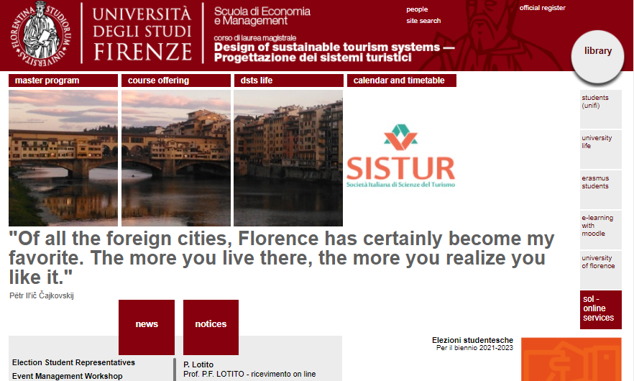
Website: www.dsts.unifi.it

Slide 4
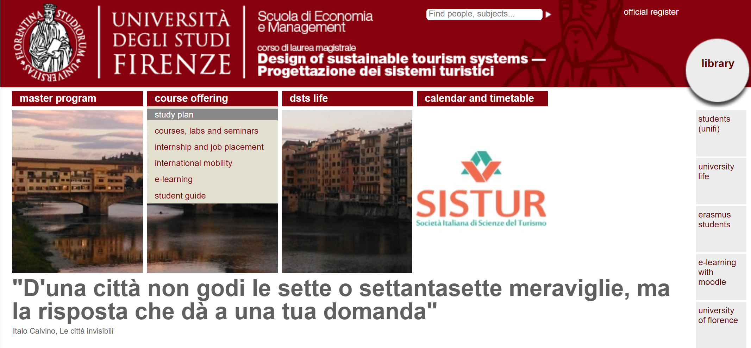
WEB SITE : www.dsts.unifi.it

Slide 5
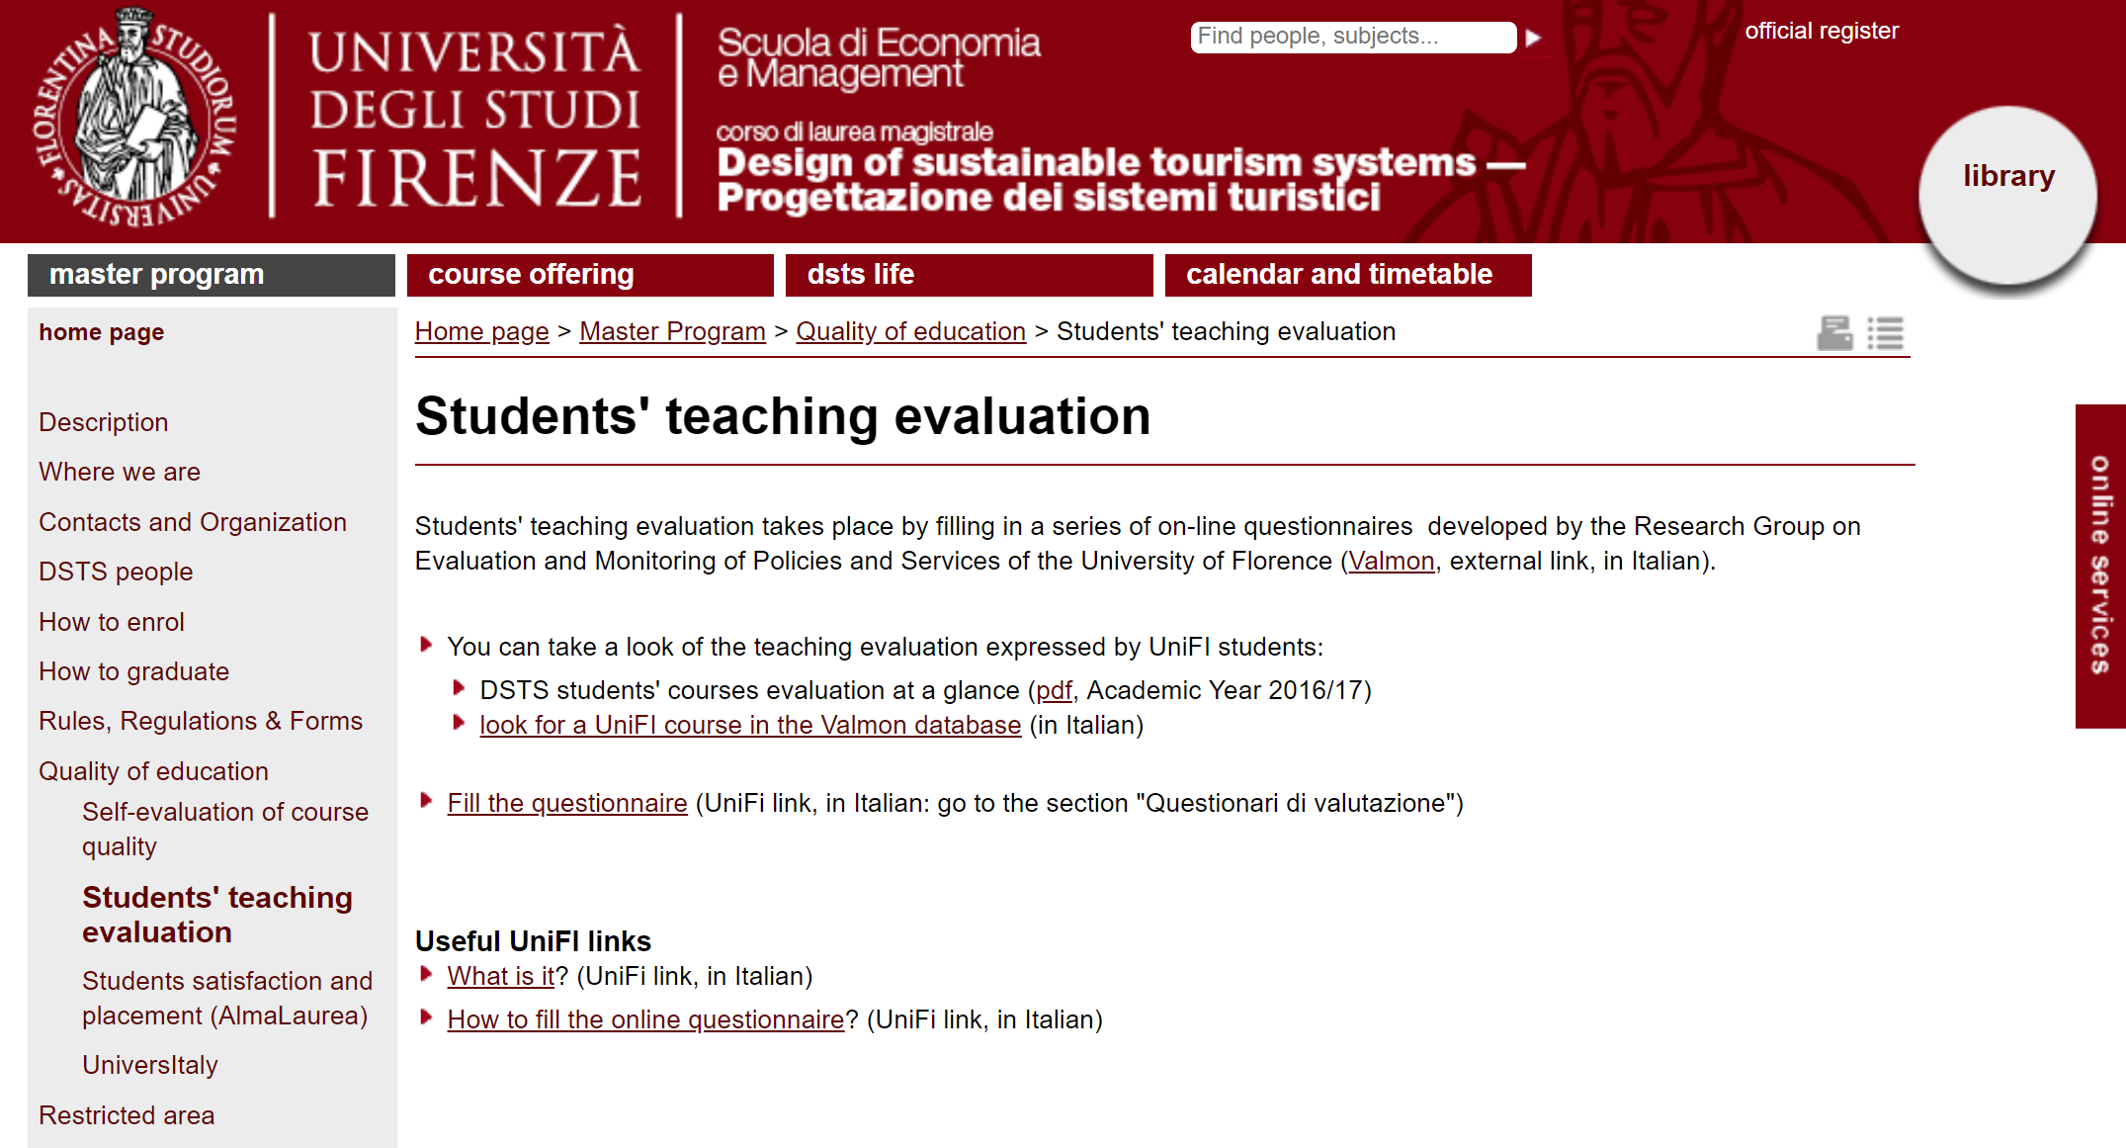
WEB SITE : www.dsts.unifi.it

Slide 6
Study Plan

Slide 7
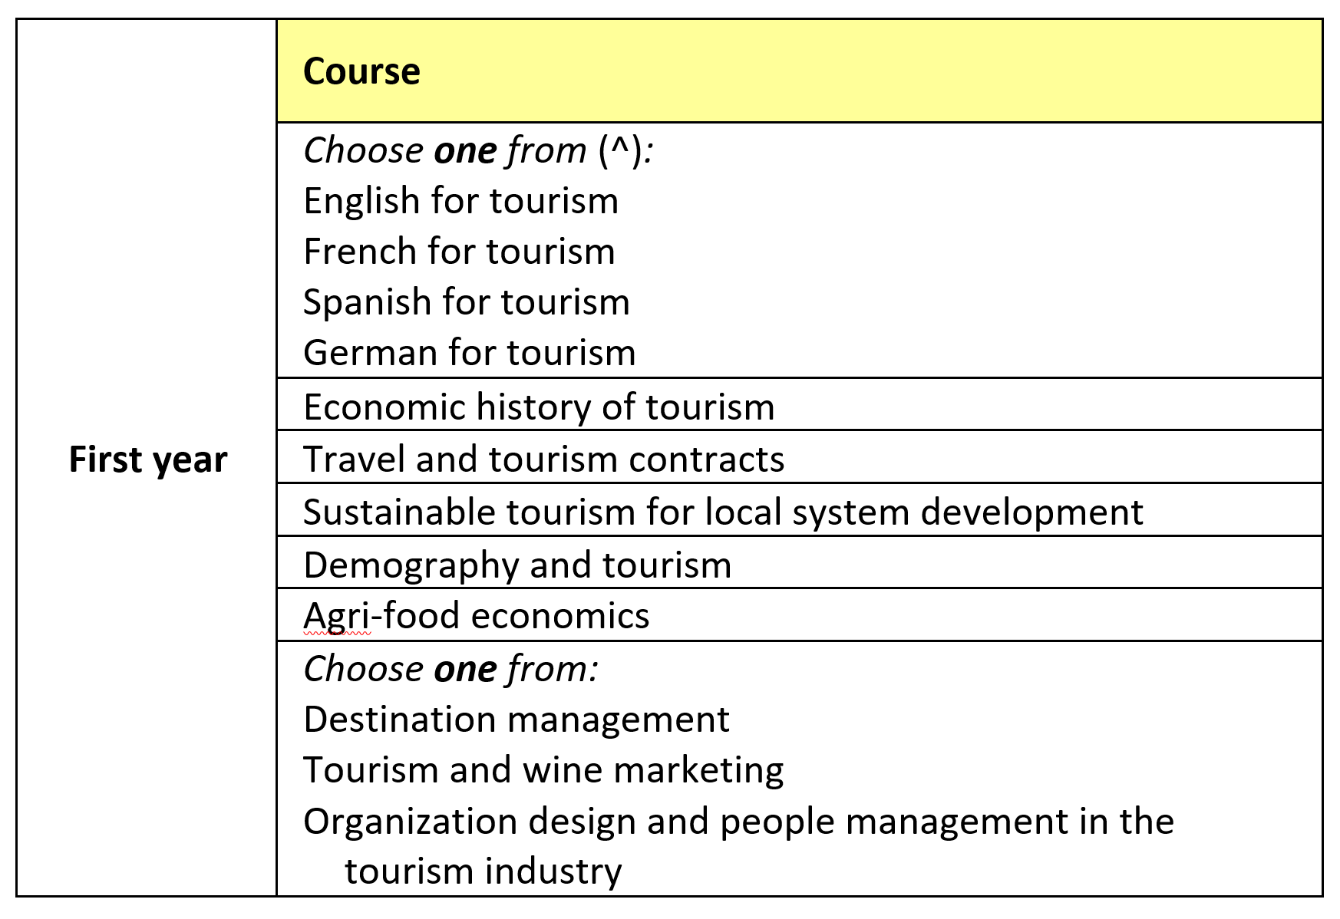

Slide 8
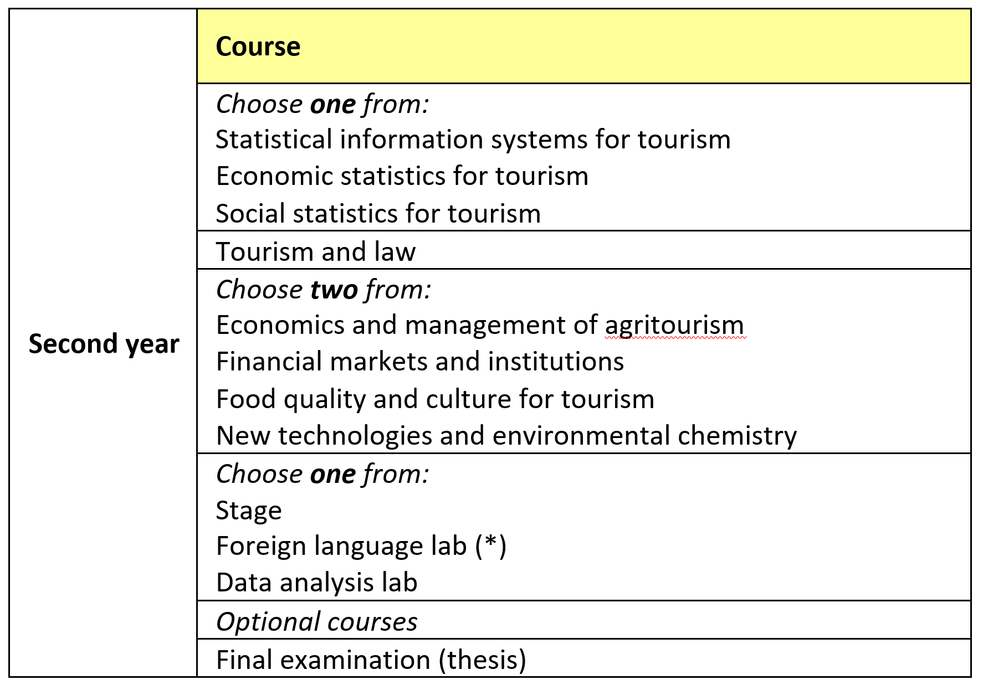

Slide 9
First year, first semester
One exam of foreign language (9 credits)
Economic history of tourism (9 credits)
Destination management (OR Tourism and wine marketing; but only after Destination management) OR Organization design and peopple management in the tourism industry (9 credits)
→ You may also attend any future exam (for example: Computer lab, 3 credits) and attend propedeutic courses of foreign language (remember: you must study a foreign language different from English; two foreign languages if native English)

Slide 10
English, French, German, Spanish
Courses are offered by the master program. There are also propedeutic labs for accessing advanced level courses
Other languages (Italian excluded)
To be motivated
Before attending, be sure that the course can be accepted in the study plan. Please contact Prof. Ilona Cziraky.

Slide 11

Courses of Italian language
Special course (no fees) reserved for DSTS students:
A1-A2 level: 1° semester (check the news on our website)
B1/B2 level: 2° semester
For more information: Language Center of UNIFI (CLA): www.cla.unifi.it

Slide 12
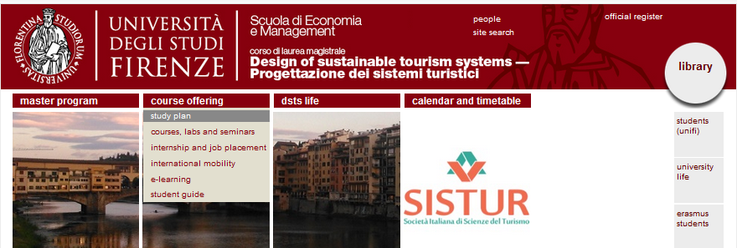
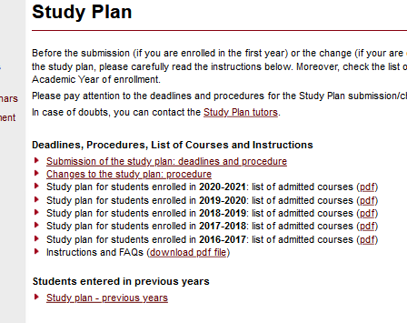
Study plan FAQs
Check our website:
course offering ➔ study plan

Slide 13
Study plan FAQs
Study plan submission
Online procedure in October/November. Deadlines will be communicated. Students are required to fill their study plan the first year (otherwise things can become complicated!)
For those who miss the deadline: April/May
Only one change per year
Study plan changes
Following the deadlines for the submission (online procedure)
For urgent changes only for students who are about to graduate: extraordinary procedure (paying a fees)

Slide 14
Study plan FAQs
Foreign language(s):
The study plan must include (at least) a 9‐credit exam in a language different from English and from your mother tongue.
You can choose between: French/German/Spanish for tourism. Then you can include other language credits (e.g., lab or 9-credit exams in the optional exams)
The choice of English as the 9‐credit exam is possible only if you can demonstrate to know another language (different from English) at the C1 level or higher. In this case, you have to include also at least a 3 credit language lab (different from English and your native language). We suggest: Italian language lab.

Slide 15
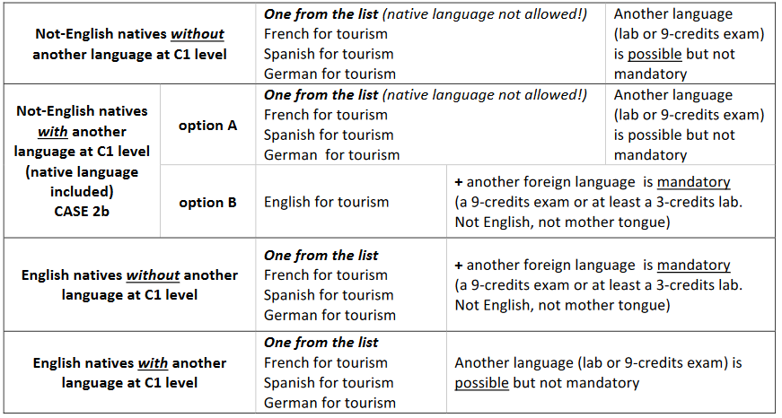
Study plan FAQs
Foreign language(s):

Slide 16
Study plan FAQs
18 optional credits
from the DSTS exams non selected as mandatory
from the UniFI Master Program offer. These course have to be consistent with the DSTS program.
Stage
A max of 6 credits as stage can be included
Credits without mark
Some courses (generally 3 cfu ones) are not evaluated with a numerical mark. A max of 6 credits of such courses may be included in the study plan (included the mandatory ones)
Exams in Italian language
Yes, they are allowed in the 18 free credits.

Slide 17
Study plan FAQs
For other questions, please check the Instructions and FAQs documents on the website,
and if you do not find the answer, please contact the study plan tutors:
  Prof. GRASSINI: laura.grassini@unifi.it
  Prof. PIRANI : elena.pirani@unifi.it

Slide 18
Study abroad

Slide 19
Study abroad
There are 3 possibilities:
Erasmus (UE countries)
Extra UE
Erasmus traineeship (after graduation)
Usually the application must be presented at the beginning of the year (January-March), and it is recommended to apply in the first year.
The period abroad: one semester
https://www.economia.unifi.it/vp-273-programma-erasmus-2021-27.html

Slide 20
Miscellaneous

Slide 21
Student ID, PW and badge
After the enrolment, you receive:
a student number (ID) and a password for accessing the web services of UNIFI;
a badge for accessing the services reserved to UNIFI students (libraries, canteen, sports, etc.)

Slide 22
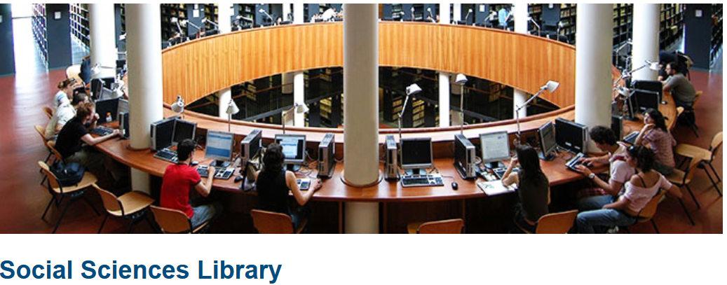
UNIFI LIBRARIES
http://www.sba.unifi.it/changelang-eng.html
http://www.sba.unifi.it/CMpro-l-s-19.html

Slide 23
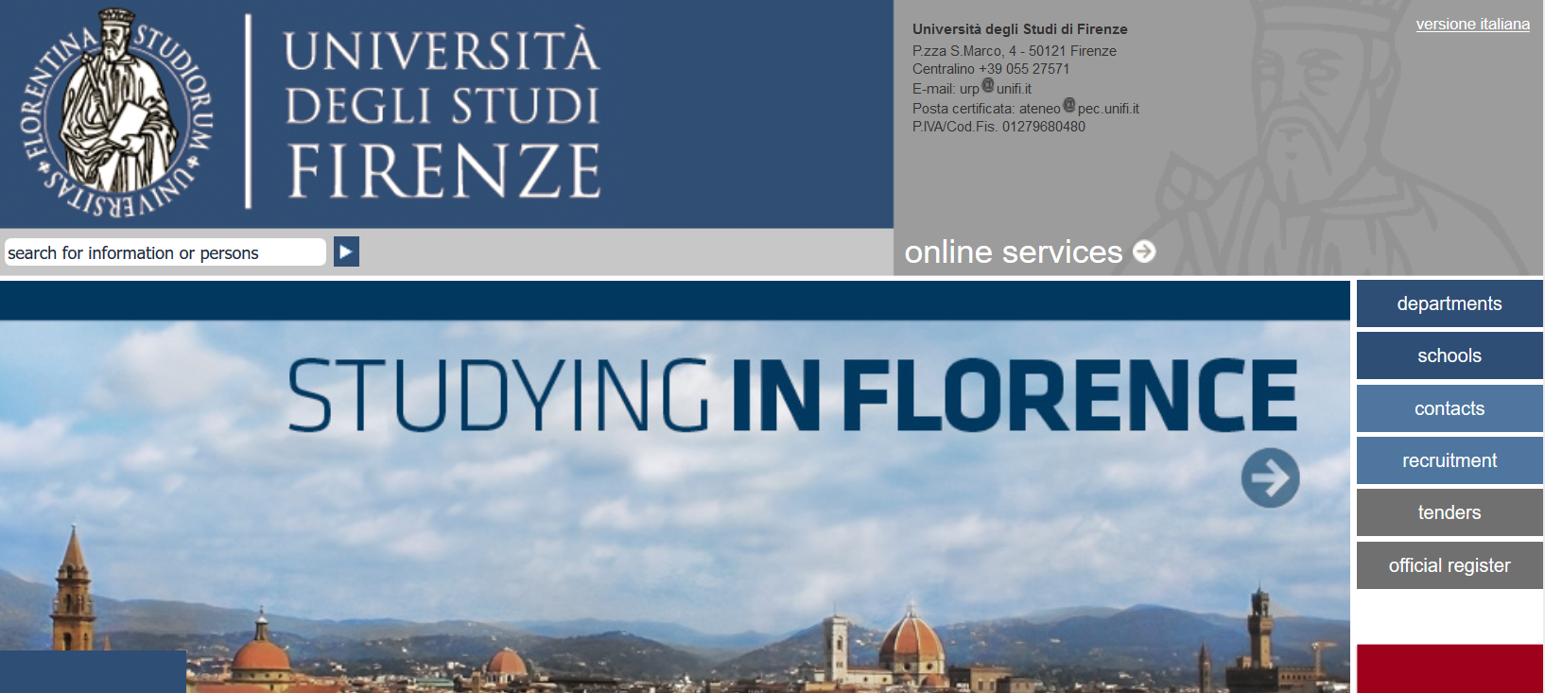
ONLINE SERVICES

Slide 24
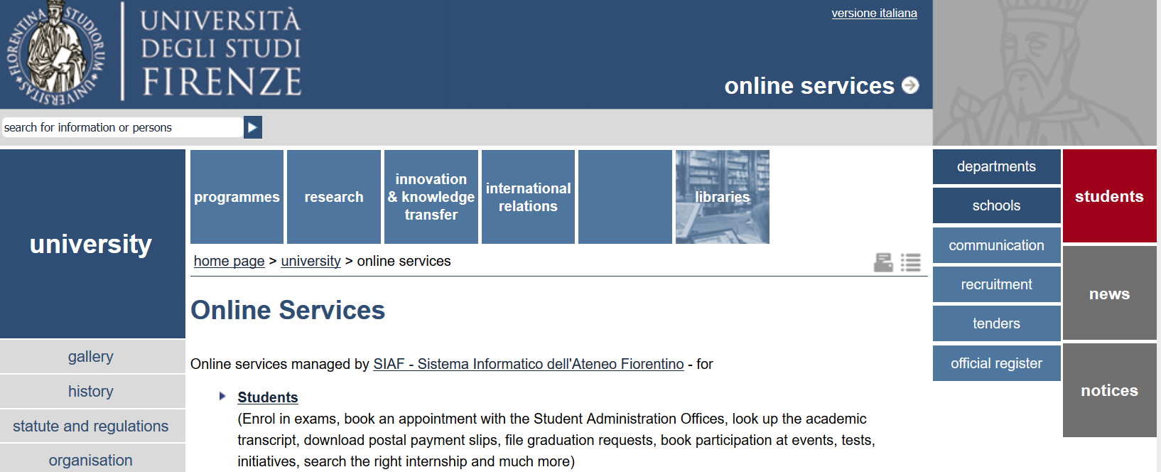
ONLINE SERVICES
STEP 1

Slide 25

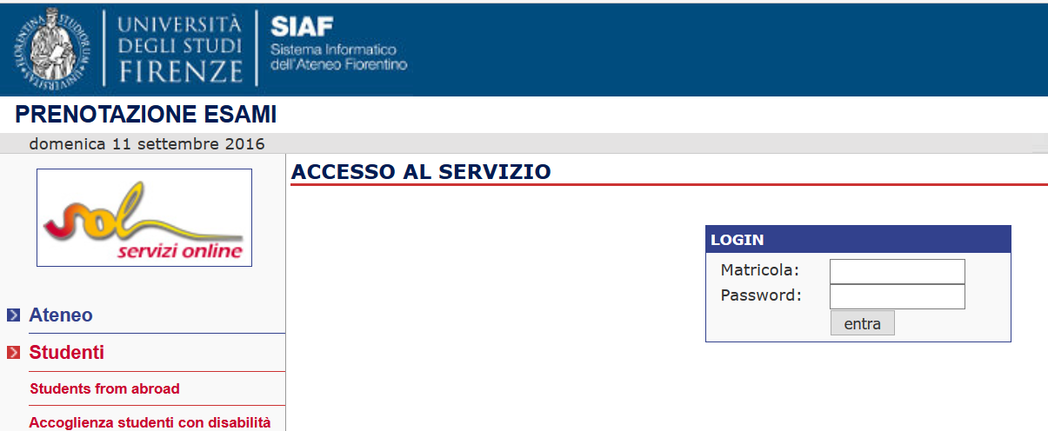
HOW TO: CHECK THE UNIFI EMAIL, BOOK EXAM ONLINE , FILL OUT STUDY PLAN
STEP 3

Slide 26
STUDENT E-MAIL
name.surname@stud.unifi.it
If there are two John Smith:
john.smith@stud.unifi.it
john.smith1@stud.unifi.it
REMEMBER TO CHECK YOUR STUDENT E-MAIL!!

Slide 27
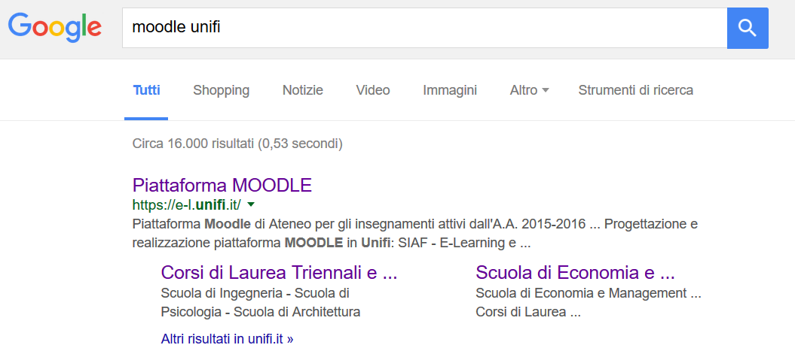
HOW TO ACCESS THE MOODLE PLATFORM
ONLINE LEARNING RESOURCES: MOODLE platform
STEP 1

Slide 28
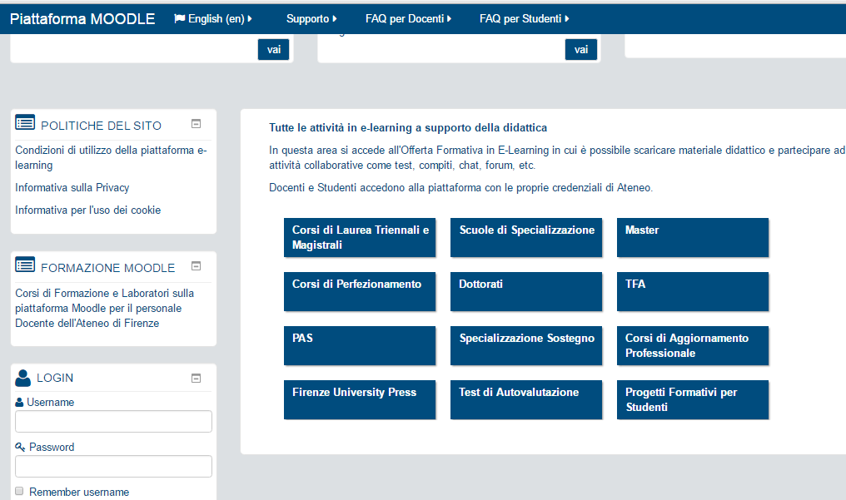
HOW TO ACCESS THE MOODLE PLATFORM
STEP 2

Slide 29
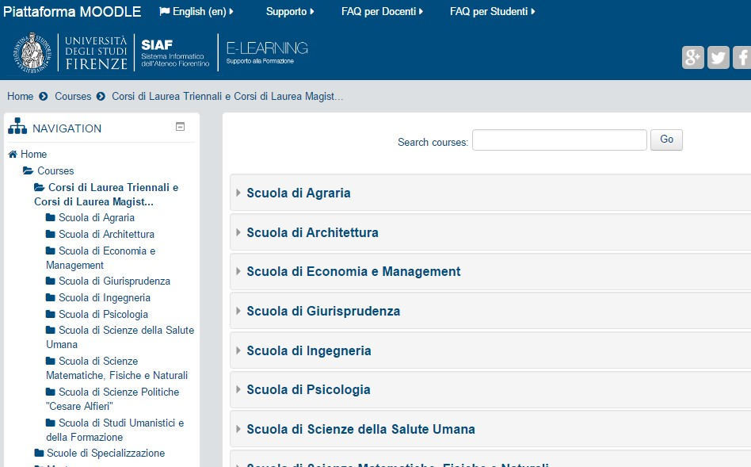
HOW TO ACCESS THE MOODLE PLATFORM
STEP 3

Slide 30
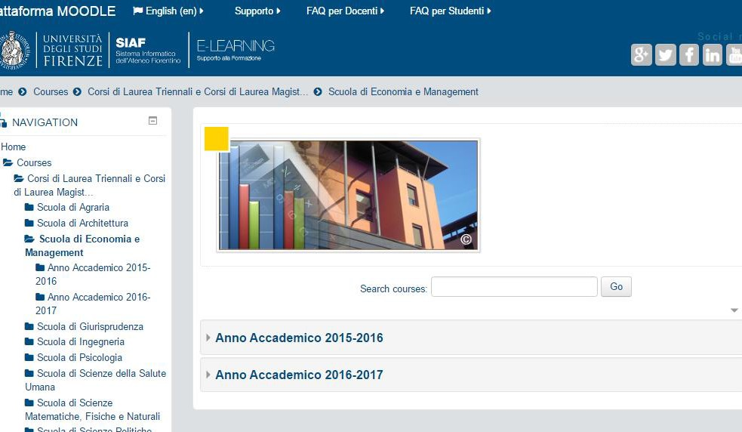
HOW TO ACCESS THE MOODLE PLATFORM
STEP 4

Slide 31
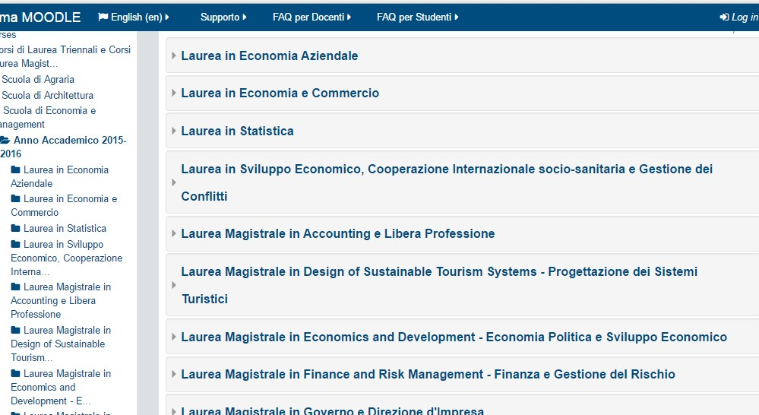
HOW TO ACCESS THE MOODLE PLATFORM
STEP 5

Slide 32
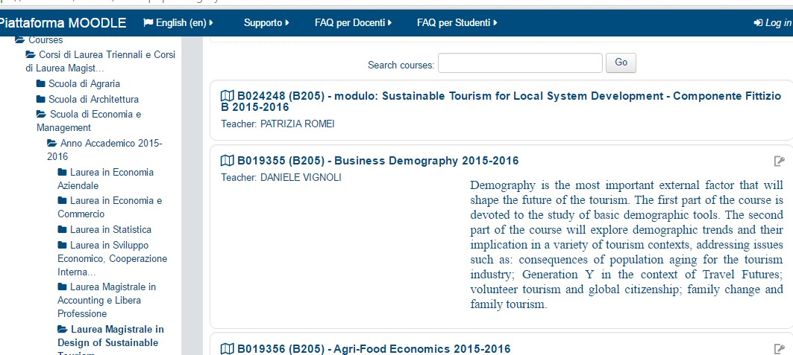
HOW TO ACCESS THE MOODLE PLATFORM

Slide 33
CONTACTS
Director of the Master Program
Prof. Laura GRASSINI
laura.grassini(AT)unifi.it
Tutors
Prof. Francesca GIAMBONA
francesca.giambona(AT)unifi.it
Prof. Elena PIRANI
elena.pirani(AT)unifi.it

Slide 34
CONTACTS
Study plan
Prof. Laura Grassini
Email: laura.grassini(AT)unifi.it
Prof. Elena Pirani
Email: elena.pirani(AT)unifi.it
Learning agreement, international relations and Erasmus
Prof. Daniele Vignoli
Email: daniele.vignoli(AT)unifi.it
Internships and job-placement activities
Prof. Benedetto Rocchi
Email: grassini(AT)disia.unifi.it

Slide 35
CONTACTS
Student office
informa.studenti(AT)unifi.it
ITA: https://www.unifi.it/cmpro-v-p-567.html#accesso_segreterie
ENG: https://www.unifi.it/vp-10837-student-administration-offices.html
International desk
ITA : https://www.unifi.it/cmpro-v-p-567.html#studente_straniero
ENG : https://www.unifi.it/vp-10924-international-desk.html

Slide 36
How to get in contact with a professor
http://www.unifi.it
Write the person’s surname in the website search engine
Click on the person’s name which appears
Visit the person’s page where you will find all the information (courses, office hours and special messages).
For any information with the professor, please write an email:
  using your institutional email address
  indicating master program, year of enrolment, ID number
  clearly explaining your question.

Slide 37


Slide 38
Presentation of some courses

Slide 39
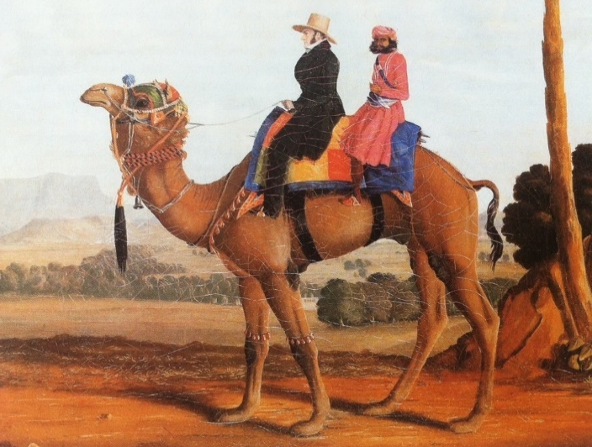
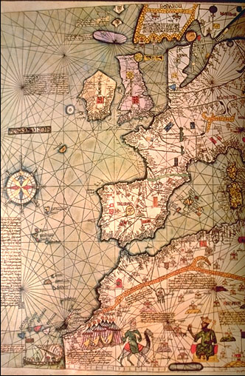
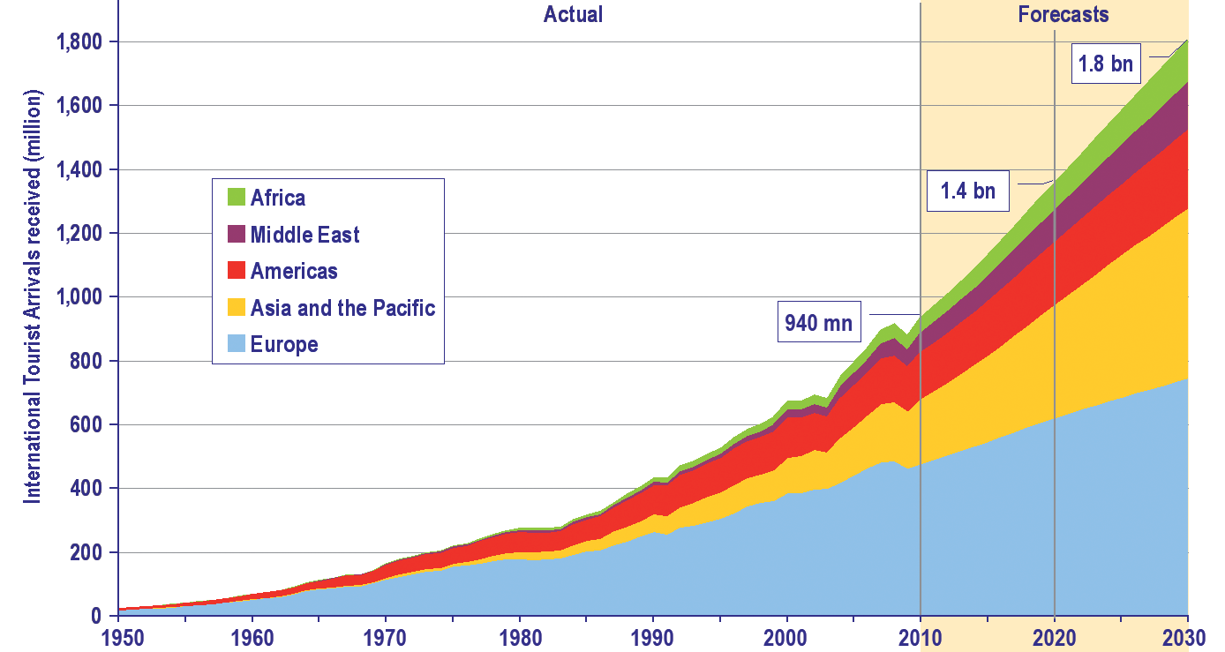
ECONOMIC HISTORY OF TOURISM
Prof. Francesco GUIDI BRUSCOLI
TRAVELLING FROM THE ANTIQUITY TO MODERN TIMES
DEFINITIONS OF TOURISM
WHAT IS TOURISM HISTORY?
DEMAND AND SUPPLY IN TOURISM
THE ORIGINS OF TOURISM
THE GRAND TOUR
THE BIRTH OF MODERN TOURISM
THOMAS COOK
MASS TOURISM
GLOBAL TOURISM

Slide 40
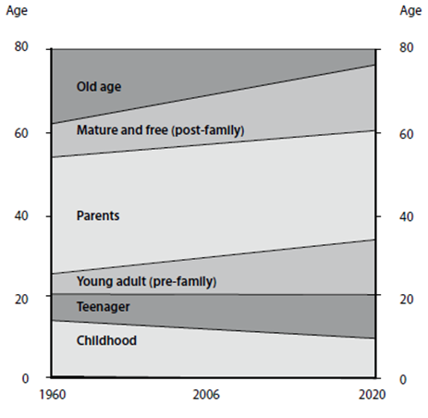
DEMOGRAPHY AND TOURISM
Prof. Daniele Vignoli
Demography is the most important external factor that will shape the future of the tourism
After being equipped with basic demographic tools, we will explore demographic trends and their implication in a variety of tourism contexts, addressing issues such as:
  Population growth, declining fertility rates, increased longevity, and immigration
  Generation Y in the context of travel futures, volunteer tourism, and global citizenship
  Family change and family tourism
Age compression: Changing age characteristics of six life-course stages that will fundamentally impact the tourism sector
Source: Schänzel et al. (2012)

Slide 41
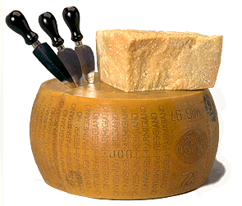
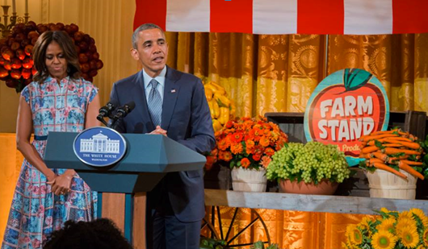
AGRI-FOOD ECONOMICS
Prof. Andrea Marescotti
MAIN CONTENTS
Basics of agricultural economics: supply, demand, market.
Characteristics and evolution of the agribusiness
The importance and evolution of the Common Agricultural Policy
Multifunctionality and the new development model of agriculture
Typical products, short food supply-chains, local products
Food and tourism
STUDENTS’ WORK
Students will be asked to produce some reports on selected topics, to be presented to the class

Slide 42
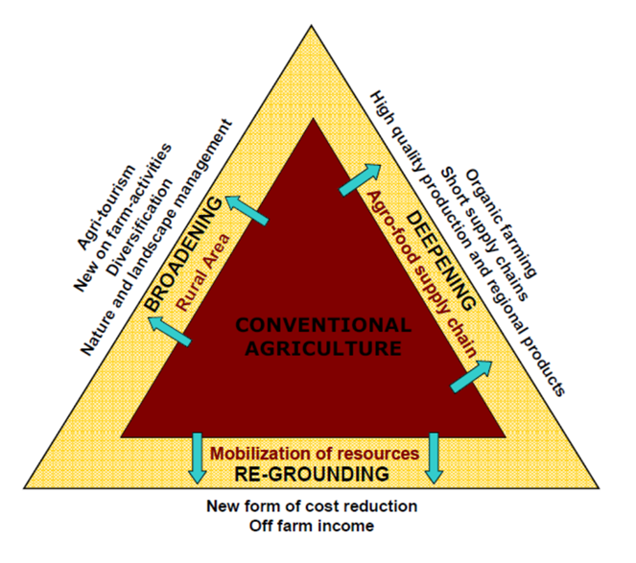
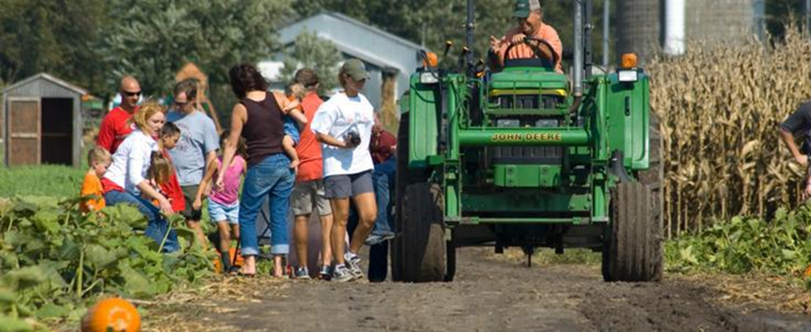
ECONOMICS AND MANAGEMENT OF AGRITOURISM
Prof. Benedetto Rocchi
MAIN CONTENTS
Setting the scene: agri vs. rural tourism.
Dealing with multifunctional farming
The economic viability of agritourism
Agritourism and sustainable rural development
Developing a marketing plan for an agritourism activity
FIELD ACTIVITY
Meeting with agri-tourism entrepreneurs from two rural areas in Tuscany: presentation of business cases and discussion of management issues

Slide 43
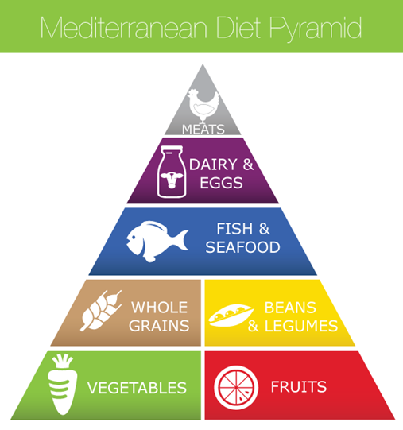
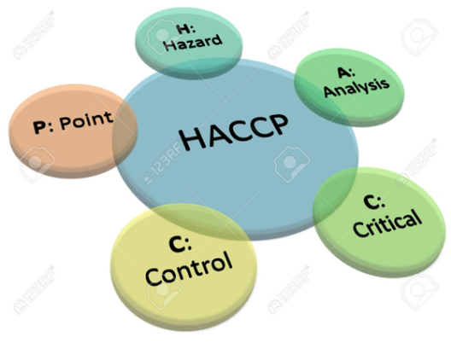
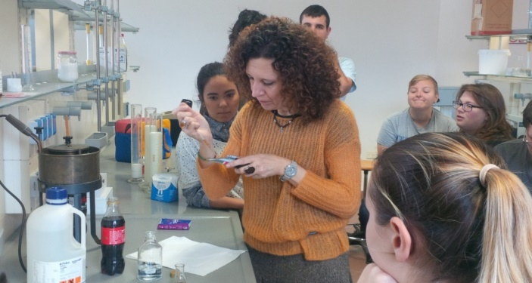
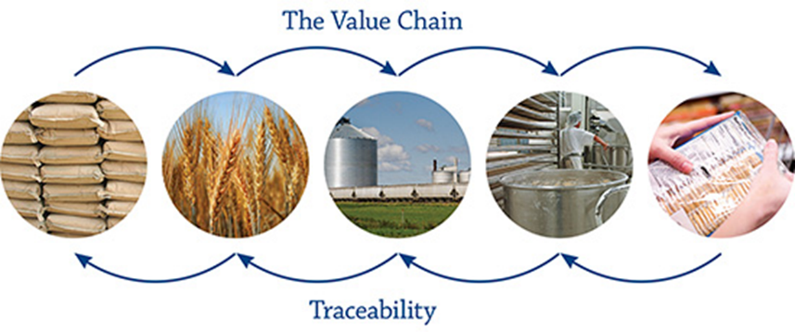
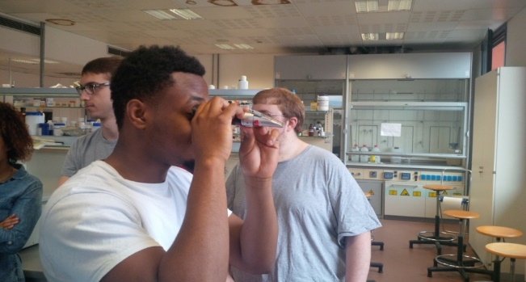
FOOD QUALITY AND CULTURE FOR TOURISM
Prof. Patrizia Pinelli
Mediterranean Diet Pyramid
What are the positive and negative impacts of food globalization?
MAIN CONTENTS
Food classification, dietary principles and frauds
Water as a natural resource
Food preservation methods and packaging
Food safety management systems and HACCP
Food Globalization, Politics, and Sustainability
EXPERIMENTAL PART
Analytical detection methods for the food quality assessment: densitometry, refractometry, viscosimetry and microscopic analysis (Mer.Qu.Ris Laboratory, D15, III floor)

Slide 44



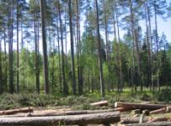
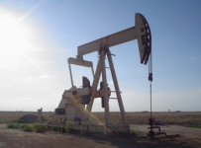
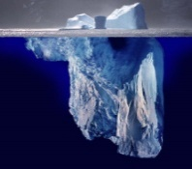
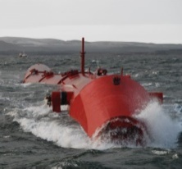
NEW TECHNOLOGIES AND ENVIRONMENTAL CHEMISTRY
Prof. Annalisa Romani
MAIN TOPICS
Reserve and Resources. Natural Resources and sustainable productions
Prospects for new technology improvement and innovation
Environment and Safety, Climate change.Enviromental and social impacts
Water as resource, drinking water, desalination technologies
Energy resource, Energy Management and Bioenergy
Biomass as resource. Biomass for new production and energy
Land pollution
Quality and certification. Envairomental management system
Touristic and Territorial Microenterprise and innovation.
LAB ACTIVITY and Integrative Activities
envairomental gas detection, radioactivity detection, (Mer.Qu.Ris Laboratory, D15, III floor). Bioeconomy and green economy: from theory to practice. Case Study of Tuscan Micro- Enterprise.

Slide 45

ORGANIZATION DESIGN AND PEOPLE MANAGEMENT IN THE TOURISM INDUSTRY
Prof. Daria Sarti
MAIN CONTENTS
Organizations in the Tourism Industry: peculiarities
Basic principles of organization design
Defining management and leadership
Organizational culture and change management
Motivation theories to lead people
Main activities of the HR Department in the Tourism Industry (recruitment, selection, HR training and development, performance management and reward management)
IN CLASS ACTIVITIES
Attending students will be asked to actively participate in class activities (case studies, exercises and guest lectures) and produce a final project report on selected topics.

Slide 46


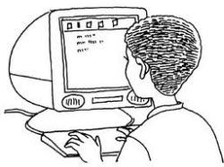

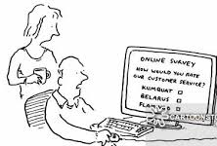





SOCIAL STATISTICS FOR TOURISM
Prof. Elena Pirani and Valentina Tocchioni
What we will discuss in this course:
How to craft a good survey instrument
There is never an option
that reflects exactly what
I want to say!
How to design effective survey questions
How to make some
description of
data collected
Some rudiments about statistical
text analysis

Slide 47
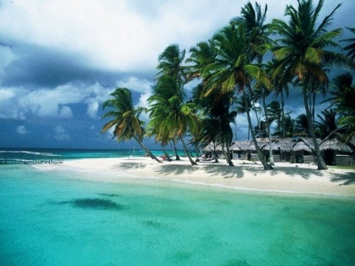
ECONOMIC STATISTICS FOR TOURISM
Prof. Francesca Giambona
Economics (the only field in which two people can get a Nobel Prize for saying exactly the opposite thing)
+
Statistics (the art of never having to say you're wrong)
=
Economic Statistics
THE QUANTITATIVE DESCRIPTION OF THE ACTIVITY OF TOURISM SYSTEMS
Time Series Analysis and Forecasting
Composition Model
Exponential Smoothing Models
THE QUANTITATIVE DESCRIPTION OF THE OF TOURISTS’ DEMAND
THE QUANTITATIVE DESCRIPTION OF TOURIST ENTERPRISES’ PRODUCTION
The Role of Prices
Time and Space Comparisons
The Interdependencies of the Economic System

Slide 48



DATA ANALYSIS LAB
Prof. Laura Grassini & Prof. Daniele Vignoli
Introduction to key statistical tools for data analysis
Questionnarie construction and implementation (Lab sessions with LimeSurvey)
Basic data processing and analysis (Lab sessions with STATA)

Slide 49
internships at important and well-known farms and wine producers
WINE and TOURISM cv
Committee: prof Andrea Marescotti, Prof. Benedetto Rocchi,
Prof. Vincenzo Zampi, Prof. Filippo Randelli
Selection of students for internships at important and well-known farms and wine producers
Special cv with the following exams:
First year
Agri food economics
Sustainable tourism for local system development
Destination management
Second year
Food quality and culture for tourism
Economics and management of agritourism
To be selected as optional exams:
Tourism and wine marketing
New technologies and environmental chemistry

