Slide 1
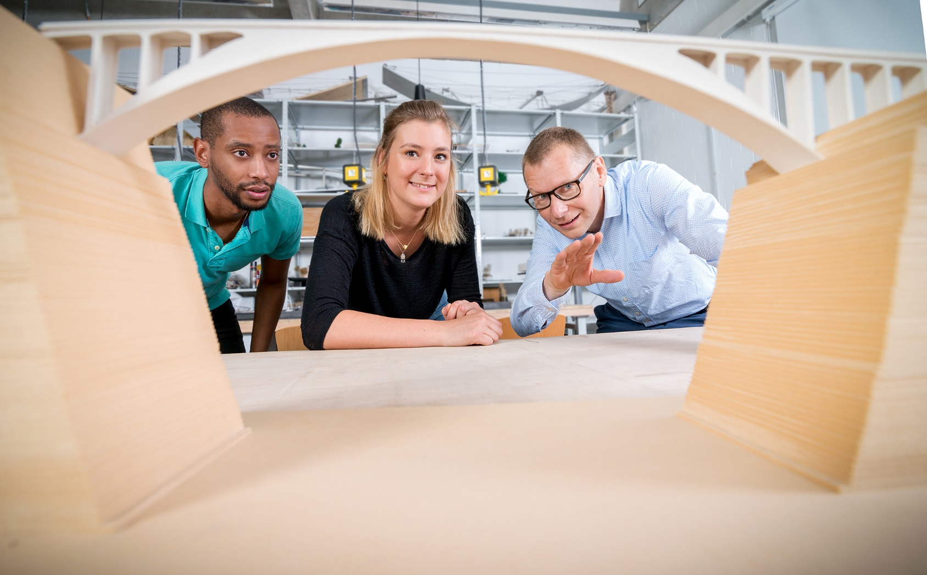



Slide 2
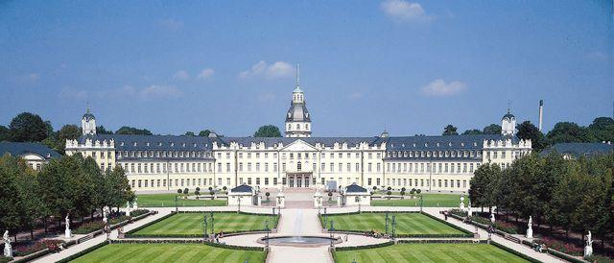
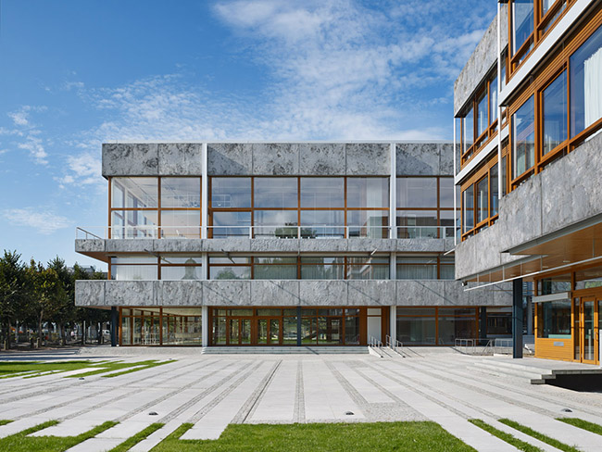

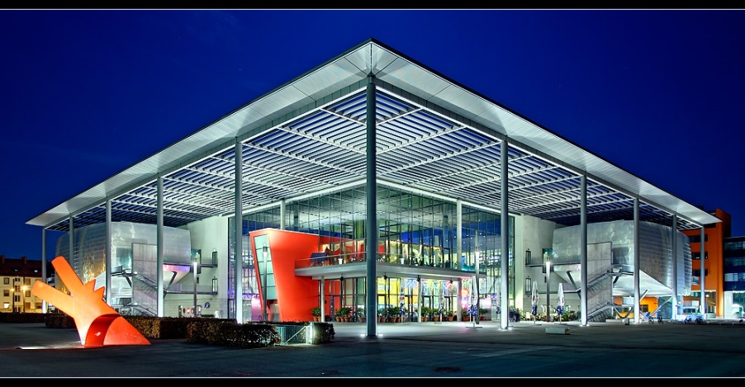
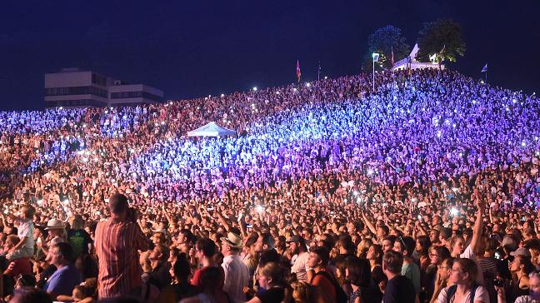

/// Location
Karlsruhe
Germany’s city ”fittest for the future“
Morgenstadt City Index 2016
City of Culture & Creativity
ranked 2nd amongst Europe‘s medium-sized cities in 2017 ”Cultural & Creative Cities Monitor“
Germany’s most bicycle-friendly city
ADFC 2019
Excellent public transport
Center of one of Europe’s top technology regions
Germany’s capital of justice
Seat of the Federal Constitutional Court and the Federal Court of Justice

Slide 3
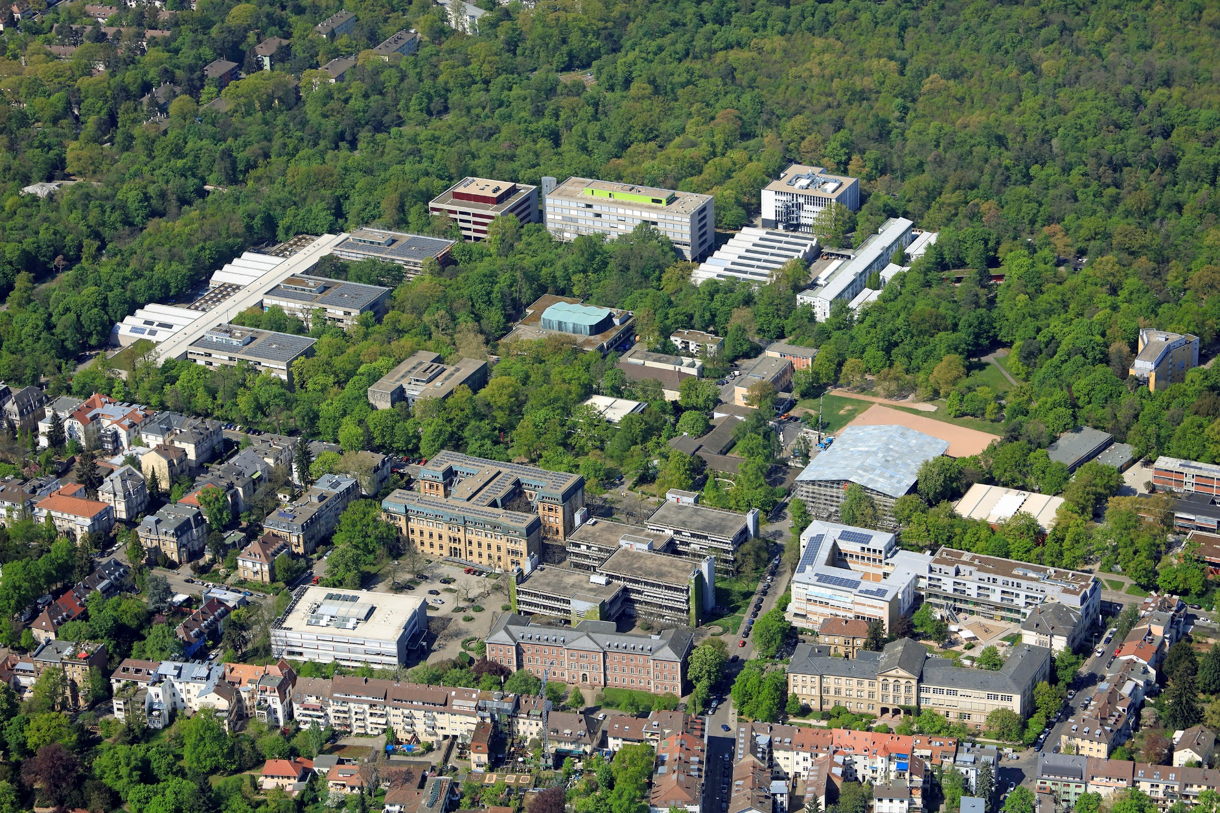
/// Location
HsKA main campus

Slide 4
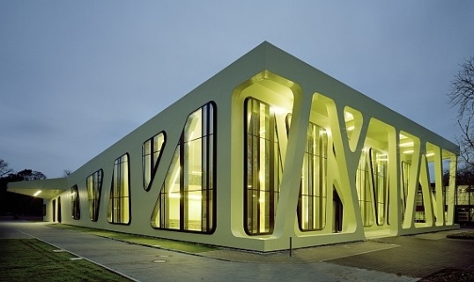
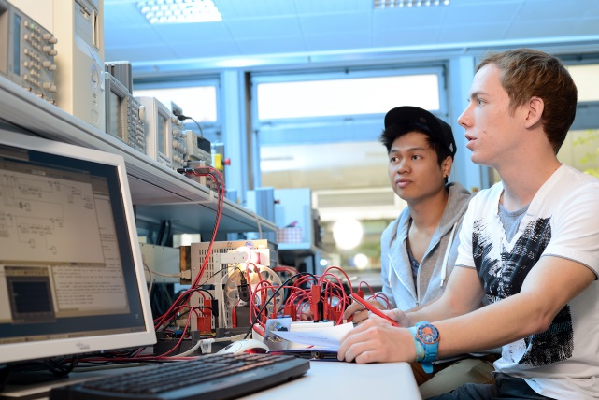
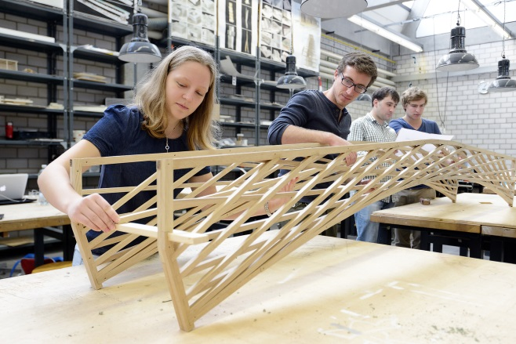
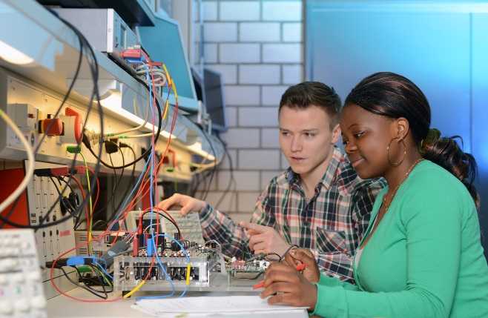
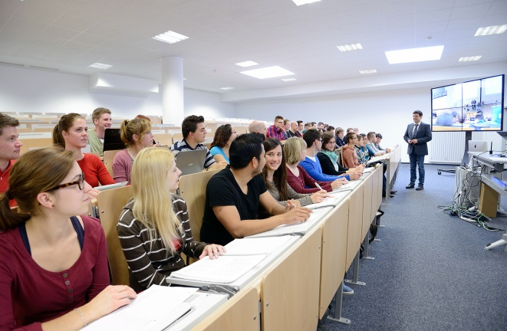
/// HsKA
Impressions

Slide 5
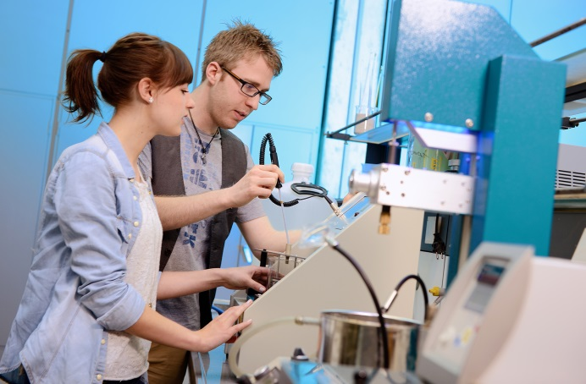

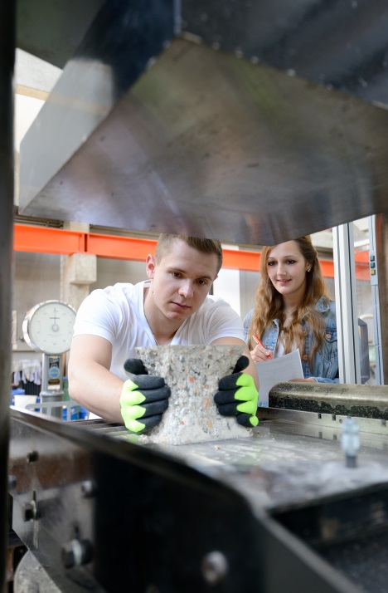
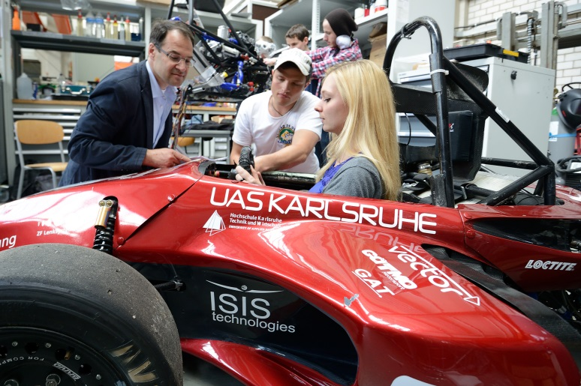
/// HsKA
Impressions

Slide 6

/// HsKA
Faculties
▪ Architecture & Civil Engineering
▪ Computer Science & Business Information Systems
▪ Electrical Engineering & Information Technology
▪ Information Management & Media
▪ Management Science & Engineering
▪ Mechanical Engineering & Mechatronics
▪ 19 Bachelor’s programs
▪ 20 Master’s programs
▪ Cooperative PhD programs

Slide 7

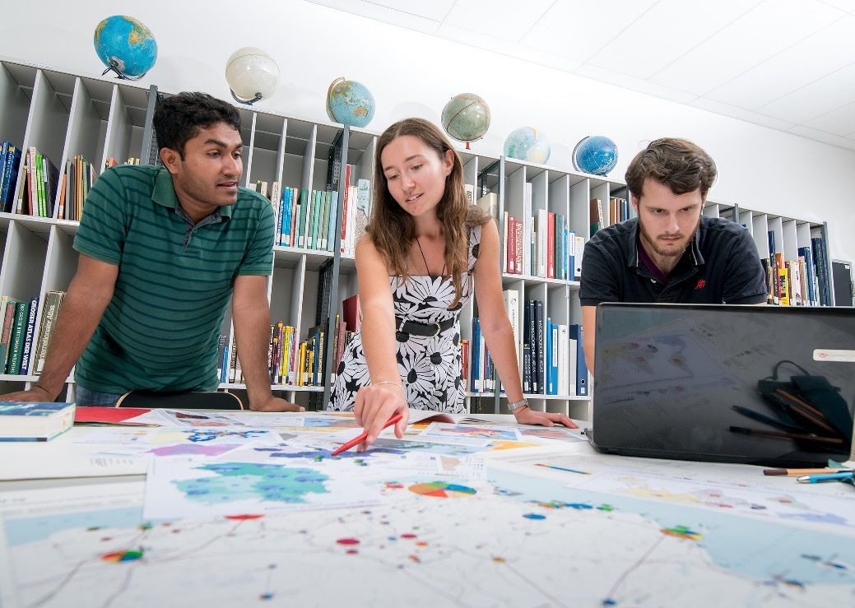
/// An international university
Options for incoming exchange students
Study semester in German (30 ECTS max.)
Study semester in English (HsKA International Program, 30 ECTS max.)
Paid internship in industry (95 working days min., 30 ECTS)
Industrial project on campus
Two-week intensive German language course before the
start of the semester
German language courses during the semester
Application deadlines: May 15th, November 15th
Living expenses: approx. 700 €/month
Study fees for non-EU degree-seeking students: 1,500 €/semester

Slide 8


/// An international university
HsKA International Program (1)
Engineering & Sciences
Aircraft Navigation (2 ECTS)
Aviation Meteorology (2)
Design Exercises 1 (4)
Design Exercises 2 (4)
Digital Signal Processors (2)
Laboratory Sensors (1)
Business & Economics
Advanced Manufacturing (2.5)
Bionics (2.5)
Enterprise Resource Planning - focus on Business administration (5)
Financial Controlling of Purchasing and Sales (2.5)
Financial Controlling of Services (5)
Information Technology (2.5)
International Marketing and Strategic Innovation (2.5)
Project Management (5)
Computer Science & Bus. Information Systems
Augmented Reality (6)
Chatbots (2)
Customer Collaboration Project (10)
Enterprise Resource Planning - focus on computer
science (5)
Intercultural Communication (2)
International Strategic Management (5)
International Business Networks (5)
Programming Paradigms (3)
User-Centered Design (5)
Virtual Reality Apps (6)
All courses subject to change due to the COVID-19 pandemic.

Slide 9

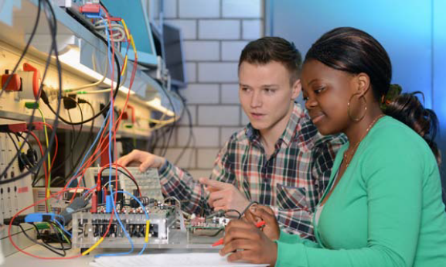
/// An international university
HsKA International Program (2)
Interdisciplinary Studies
Accessing the German Labor Market (2)
Design Thinking (2)
Digital Content Management (2.5)
Digital Failure Diagnosis (2)
Electric Power Systems (2)
Energy Storage Lab (2)
Future Leadership 4.0 (2, 2 seminars)
Geothermal Heat and Power (2)
Get Ready for the Job – Working with Global Players (2)
Global Financial Markets (4)
Global Economy (2)
Innovation Management for Technical Products (2)
Intercultural Management Communication (2)
International Financial Markets (2)
International Marketing (2)
International Project Management (2)
Introduction to Machine Learning (2)
Introduction to Project Management (2)
Machine Learning in Python (2)
Personal Development and Career Design (2)
Presentation Techniques (2)
Reliability Engineering compact (3)
Renewable Energy (2)
Renewable Energy Storage (2)
Sensors (2)
Strategic International Human Resource Management (2)
Strategic Management (2)
Supply Chain Management (2)
Time matters – how to effectively manage your time… and yourself (2)
Virtual Reality for Industrial Application (3)
All courses subject to change due to the COVID-19 pandemic.

