Slide 1


Master Program
(LM56 Scienze dell’Economia)
Notes:
1

Slide 2
Info on the web
MSc website:
https://www.development-lm.unifi.it/
select Master Programme and then Presentation
Enrollment info
Booklet 2025-26 (in page Presentation in the website)
Testimonials
The platform FEDERICA offers videos on MSc
presentation, brief lectures from a few courses: International
Trade, Computational Economics, Behavioural and Social
Evolution, Agriculture Development and Poverty (access to
FEDERICA through the page Presentation in the website)
Notes:
2

Slide 3
MSc main features (1)
All teaching takes place in English
International environment
Only 47% students currently enrolled are Italian (83 out
of 177).
International mobility: Erasmus+, Double degrees.
Interdisciplinary approach to teaching
Economics
Courses and laboratories in
Economics, Econometrics, Statistics, Mathematics, Finance, Matlab, Phyton, R, Stata, Law, Economic History, Political Science, …
Notes:
3

Slide 4
MSc main features (2)
2 curricula:
    Economics
    Development Economics
Best course of study of the School of Economics and Management at Unifi in terms of evaluation of courses by students.
Excellent student to staff ratio
2 grants awarded to first-year students, 1 per curriculum
Notes:
4

Slide 5
Job opportunities LM-56
- International organizations (WB, IMF, OECD, EU, etc)
- Finance (banks, insurance companies, etc.)
- Private Sector Companies (multinationals, consulting firms, etc.)
- Public servants (central end local administrations)
- Central banks (national and European)
- National and international NGOs
- Economic research centers
- Teaching Economics and Law in high school
- PhD, Academic career
Notes:
5

Slide 6
Job Placement (I)
Graduates of the MSc have very good job placements, for instance:
Private sector
Capgemini S.p.A, Deloitte, Findomestic Banca SpA, Accenture, MedTech Europe-Brussels, CCH® Tagetik, Menarini, Monte dei Paschi di Siena Capital Services, Fincantieri, ATMOsphere-Brussels, European Innovation Council and SMEs Executive Agency (EISMEA)-Brussels, Starkmacher e.V.-Germany, Pagasa Social Center-Philippines, Lilly, General Electric, Louis Vuitton, Amazon, Alten Italia, Baker Hughes, JSB Solutions, PricewaterhouseCoopers, Unicoop…
International Organizations and Central Banks
European Central Bank, Bank of Italy, UNCTAD-WTO, UNICEF, FAO, World Bank,…
Notes:
6

Slide 7
Job Placement (II)
Social sector
Starkmacher e.V.-Germany, Pagasa Social Center-Philippines, AMU Azione Mondo Unito, Action Aid, PerMicro,…
Research centers and Public sector
CNR, Sace Simest Cassa Depositi e Prestiti, Centro Studi Confindustria, RAI - Radiotelevisione italiana S.p.A., European Institute of the Mediterranean, School of Public Health (UofA – CUP)-Canada, MEF-Ministero dell’Economia e delle Finanze, Robert Schuman Centre for Advanced Studies-European University Institute, ARCO research center, European Innovation Council and SMEs Executive Agency (EISMEA)-Brussels, IRPET, IFEL,…
Notes:
7

Slide 8
PhD admission
Graduates of the MSc have entered PhD programs at the following Universities
In Italy
University of Bologna
Delos University of Florence
Pegasus University of Florence&Pisa&Siena
IMT Lucca
Università Politecnica delle Marche
Bicocca University -- Milan
Università Cattolica del Sacro Cuore – Milan
Università Federico II -- Naples
University La Sapienza Rome
University of Roma Tor Vergata
University of Pisa
Scuola Superiore Sant’Anna – Pisa
University of Trento
Collegio Carlo Alberto -- University of Turin
University of Insubria -- Varese
University Ca’ Foscari – Venice
PhD Statistics University of Florence
Abroad
European University Institute (Florence)
Toulouse School of Economics (France)
Goethe University of Frankfurt (Germany)
University of Goettingen (Germany)
University of Mannheim (Germany)
TUM School of Social Sciences and Technology (Germany)
Interdisciplinary Demographic Institute and University of Groningen (Netherlands)
University Carlos III, Madrid (Spain)
University of Hertfordshire (UK)
University of Reading (UK)
University of Surrey (UK)
Brown University (US)
One MSc professor organizes meetings with students interested in entering a
PhD program (one meeting hosts current PhD students who graduated in the MSc) and is available to advise and help them in preparing their applications
Notes:
8

Slide 9
Admission Requirements
1 For holders of an Italian BA, BA grade not below 99/110; for holders of non-Italian BA, a threshold is identified by the Admission Committee
Candidates who do not satisfy this condition may be asked to sit for an interview with the Admission Committee, based on a syllabus available with suitable advance.
2 ECTS earned during bachelor studies: At least 18 ECTS in Economics, 6 in Math, 6 in Statistics, plus 18 additional ECTS in Business / Economics / Law / Math / Pol Science / Stat, plus B2 English
Bachelor graduates from Unifi in Economia e Commercio, or Seci, or Economia Aziendale, or SusBus satisfy these conditions.
Missing ECTS can be earned by enrolling in single courses of UniFi indicated by the Admission Committee.

Slide 10
Two curricula
* Curriculum Economics
* Curriculum Development Economics
* Free study plan: Intermediate between the curricula
Notes:
10

Slide 11
Curriculum Economics
For whom?
Track in Economics For students who want to learn the tools of economics and econometrics to analyze major economic issues,
to formulate or evaluate economic policies at micro or macro
level, and to conduct theoretical and applied research in economics.
Track in Behavioural Economics For students interested in
theoretical and experimental analysis of individual behaviors and
institutions, taking into account the effects of psychological, cognitive,
emotional, cultural and social factors.
Two double degree programs:
One with the MSc in European Economic Studies of UBamberg, Germany
One with the International Master in Public Policies of URennes, France.
Career opportunities Ideal background for work as a professional economist in a wide range of positions in private economic consultancy agencies, business, finance, central banking, national and international organizations and governments, or for pursuing a PhD program in Economics.
Notes:
11

Slide 12
First year | Course | Ects | Sem
 | Game Theory and Microeconomics | 9 | 1
 | Advanced Microeconomics | 6 | 2
 | Advanced Macroeconomics | 9 | 2
 | Mathematics for Economics | 9 | 1
 | Statistical inference | 6 | 1
 | Corporate governance & Financial Markets | 12 | 2
 | Choose one course from Economic Law International Law | 6 6 | 1 1
Both Tracks in Economics and Behavioural Economics
Curriculum Economics

Slide 13
Second year | Course | Ects | Sem
 | Political Economy | 6 | 1
 | Choose two courses from Behavioural and Social Evolution Macroeconometrics Microeconometrics | 6 6 6 | 1 1 1
 | Choose one course from Behavioural Economics Coding for Economists Computational Economics International Trade Labour Economics and Gender Regulation and Digital Markets | 6 6 6 6 6 6 | 2 2 2 1 1 1
 | Choose 6 ects from Econometrics Lab Economics Lab Mathematics Laboratory R Lab Stata Lab Statistics Lab | 6 6 6 3 3 3 | 2 2 1-2 1 2 1
 | Optional courses and/or Traineeship | 12
 | Final Exam (thesis) | 21
Curriculum Economics
Track in Economics

Slide 14
Specializations
(12 ects optional courses)
ENERGY AND ENVIRONMENT
ENVIRONMENTAL ECONOMICS
ENERGY AND ENVIRONMENTAL ECONOMICS
FINANCE
COMPUTATIONAL FINANCE
QUANTITATIVE RISK MANAGEMENT
Curriculum Economics
STATISTICS
FUNDAMENTALS OF MACHINE LEARNING
STATISTICAL LEARNING FOR DATA SCIENCE

Slide 15
Second year | Course | Ects | Sem
 | Political Economy | 6 | 1
 | Behavioural and Social Evolution | 6 | 1
 | Behavioural Economics | 6 | 2
 | Microeconometrics | 6 | 1
 | Choose 6 ects from Econometrics Lab Economics Lab Mathematics Laboratory R Lab Stata Lab Statistics Lab | 6 6 6 3 3 3 | 2 2 1 2 1
 | Optional courses and/or Internship | 12
 | Final Exam (thesis) | 21
Curriculum conomics
Track in Behavioural Economics

Slide 16
Double Degrees for curriculum Economics
Jointly with MSc in European Economic Studies at UBamberg
International Master in Public Policies at URennes
1st year students can apply to enter these programs.
Five + five positions are available each year.
Selection occurs in February, based on BA final grade, 1st semester exams, motivation letter.
The selected students spend their 2nd year in Bamberg / Rennes. By completing the program, they earn 2 MSc degrees.
Why apply? Standard answers Gain international experience, Beco- me more competitive in labor market, Build international networks.
Specific answer for UBamberg: Rich offer of courses in 2nd year at Bamberg;
for URennes: Specialization in Public Economics.
Notes:
16

Slide 17
Curriculum Development Economics
For whom? For students interested in understanding the
economies of less developed countries, why some countries
manage to grow and reduce poverty but others do not, what
are the drivers of successful economic development and
the causes for stagnation, the design and evaluation of
policies that promote sustainable/inclusive growth,
education for all, global health, food security, reduce
income inequality, gender inequality, conflict, …
Double degree Offered jointly with the MSc in
Development Economics of University of Göttingen, Germany.
Career opportunities Ideal background for work as a professional development economist in national/international agencies, civil service appointments, NGOs, and private sector companies with interests in developing countries, or for pursuing a PhD program in Development Economics.
Notes:
17

Slide 18
First year | Course | Ects | Sem
 | Development Microeconomics | 9 | 1
 | Health and Education Economics | 6 | 1
 | Development Macroeconomics | 9 | 2
 | Statistical Inference | 9 | 1
 | Choose one course from Mathematical Methods for Economic Analysis Measurement and Causes of Poverty | 6 6 | 1 2
 | Human Development and International Cooperation | 6 | 1
 | Corporate governance & Finance for Development | 12 | 2
 | Choose 6 Ects from Econometrics Lab Economics Lab English for Economics Mathematical Methods Lab R Lab Spanish Stata Lab | 6 6 6 3 3 6 3 | 2 2 1 1 1 1 2
Curriculum Development Economics

Slide 19
Second year | Course | Ects | Sem
 | International Trade | 6 | 1
 | Choose one course from Economic Law International Law | 6 6 | 1 1
 | Choose two courses from Agriculture Development and Poverty Agri-food Economics Economic History of Globalisation Economics of Innovation Elements of Policy Evaluation Methods Environment and Development History of Economic Thought International Conflict Transformation Labour Economics and Gender Local and Industrial Development Microeconometrics Politics of Globalisation and Human Rights | 6 6 6 6 6 6 6 6 6 6 6 6 | 1 2 1 2 1 2 2 1 1 2 1 2
 | Optional courses and/or Internship | 12
 | Final Exam (thesis) | 21
Curriculum Development Economics

Slide 20
Double Degree for curriculum Dev. Economics
Double degree for curriculum Dev Economics
Jointly with MSc in Development Economics
University of Göttingen, Germany
1st year students can apply to enter this program.
Five slots are available each year.
Selection occurs in February, based on BA final grade, 1st semester exams, motivation letter.
Selected students spend their 2nd year in Göttingen. By completing the program, they earn two MSc degrees.
Why apply? Standard answers: Gain international experience, Become more competitive in labor market, Build international networks.
Specific answer: Rich offer of courses in 2nd year at Göttingen.
Notes:
20

Slide 21
















Some students engage in traineeship: Examples

Slide 22


Erasmus+ program
Exams, traineeship, and thesis abroad
Destinations
EU countries: Belgium, Croatia, Czech Republic, France, Germany, Greece, Netherlands, Portugal, Poland, Spain, …
non-EU countries: Australia, China, Colombia, Costarica, Japan, Mexico, South Korea, Turkey, UK, US, …
Notes:
22

Slide 23
Titles of some MSc theses
Democratic Backsliding – The Subnational Impact of Chinese Development Aid on Democratic Values in Sub-Saharan Africa
Climate-Conflict nexus: A microeconomic analysis of causal pathways in Burkina Faso
The impact of populistic regimes in net foreign direct investment inflow
Pandemics as health shocks: The dynamics of health and economic activities over time
Fiscal Federalism and Tax Competition. The Case of the Italian Intergovernmental Transfers
Social Networks and Labor Market: a Model of Job Search and Information Transmission through Word-of-Mouth Communication
Gender Gaps and the Sandwich Generation in the Italian Labor Market
Collusion in times of Shrinkflation
On the individual incentives to bundle in oligopoly, published in Journal of Economic Behavior and Organization 2021
General equilibrium and altruistic preferences, published in Decisions in Economics and Finance 2025
Brexit: the economic consequences of leaving Single Market
Heterogeneous expectations in a behavioural New Keynesian model with fiscal policy
The impact of monetary policy on the financial market: Evidence from the UK
Gaussian mixture models to assess the convergence of EU regions

Slide 24
Additional international activities
The Econometric Game
SIMUVACTION on Artificial Intelligence
Syracuse University in Florence

Slide 25
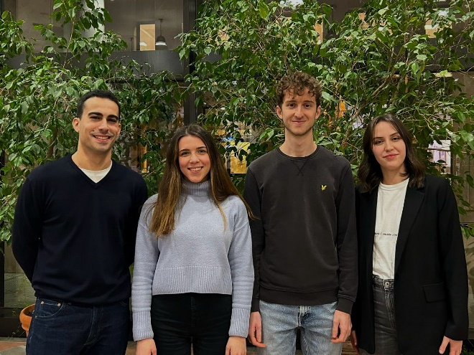
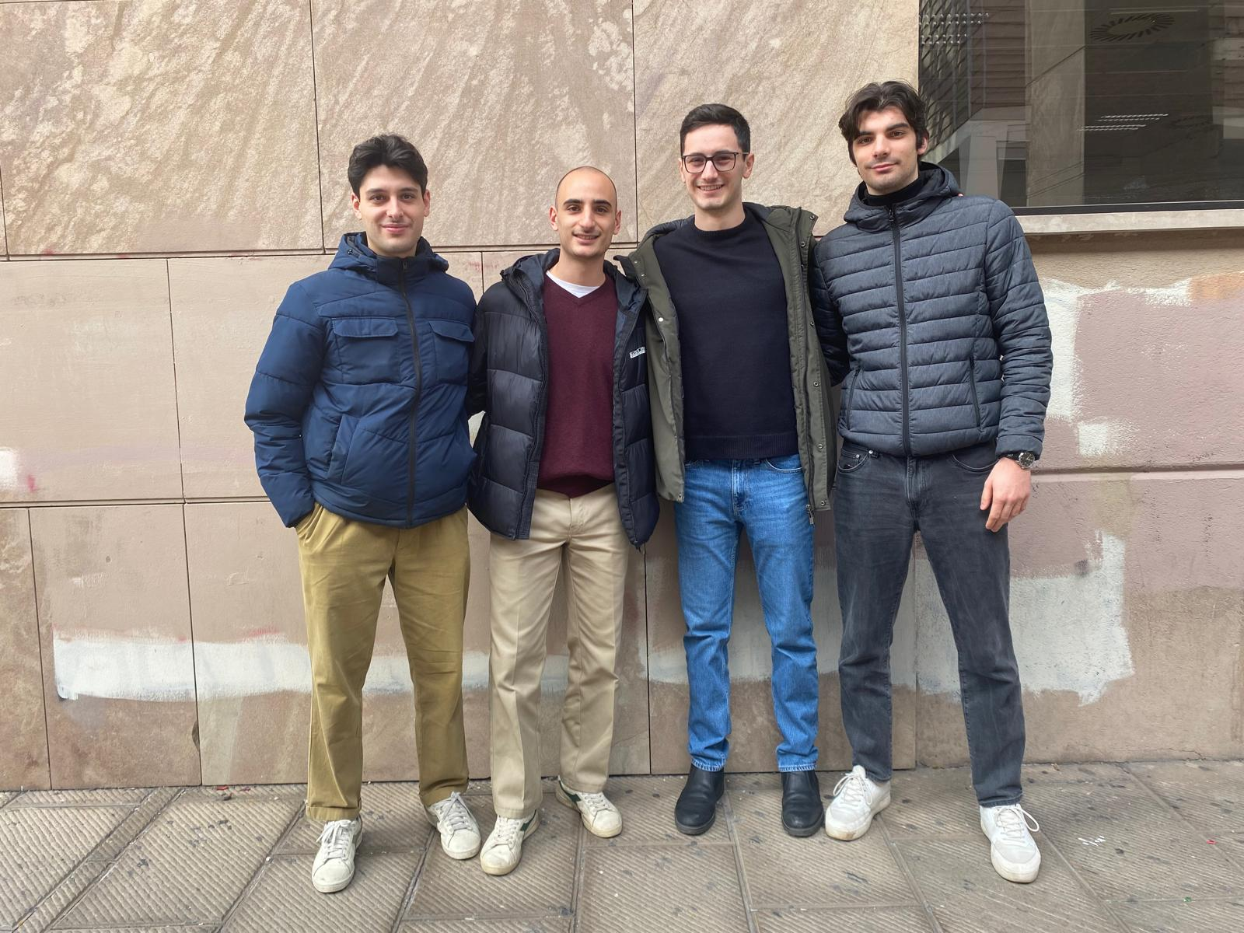
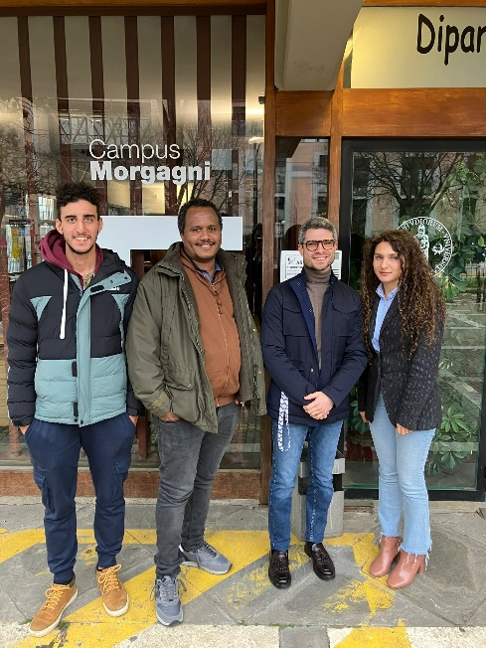
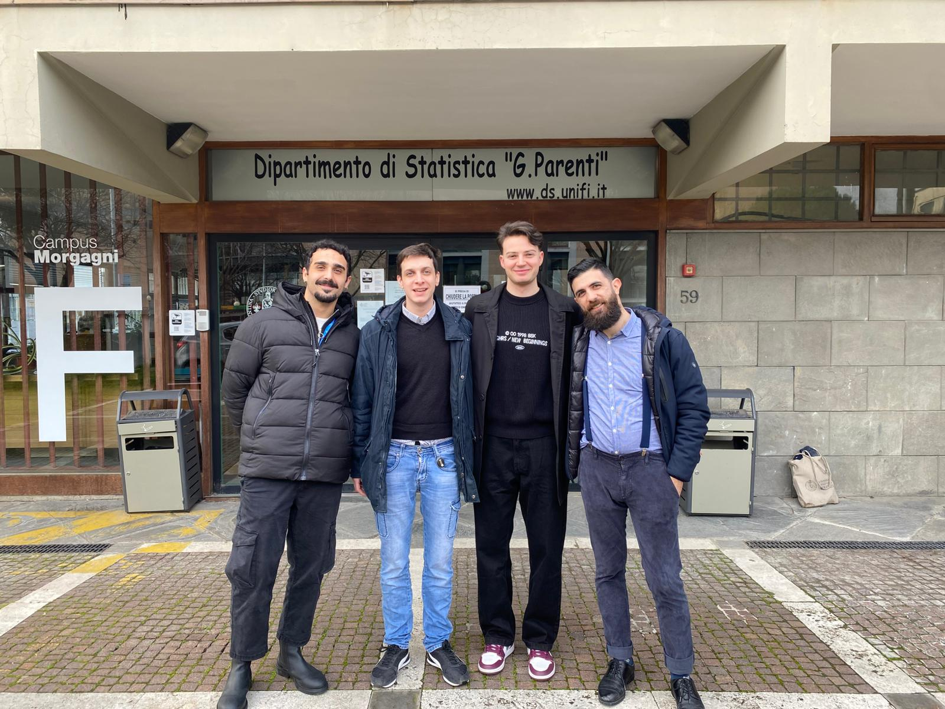

UniFi at the Econometric Game
UniFi has been selected to participate in the latest editions
of the Econometric Game, held in Amsterdam (Netherlands)
Each year, one of our students is in the Unifi team
Our Team
for year 2024
Our Team
for year 2023
Our Team
year 2026
Our Team
for year 2025

Slide 26
Universities participating in
the Econometric Game 2025
Aarhus | Leibniz (Hannover)
Aix Marseille | Maastricht
Amsterdam | Orleans
Antwerp | Oxford
Athens | Institut Polytechnique de Paris
Bologna | Poznan
Cambridge | SciencesPo (Paris)
Carlos III (Madrid) | Seoul
Copenhagen | Shg School of Economics (Warsaw)
Erasmus (Rotterdam) | Singapore
Florence | Southampton
Gent | St. Gallen
Groningen | Stockholm School of Economics
Harvard | Toronto
Lausanne | Warsaw
Notes:
26

Slide 27
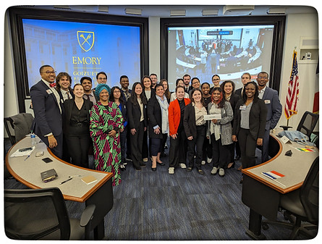
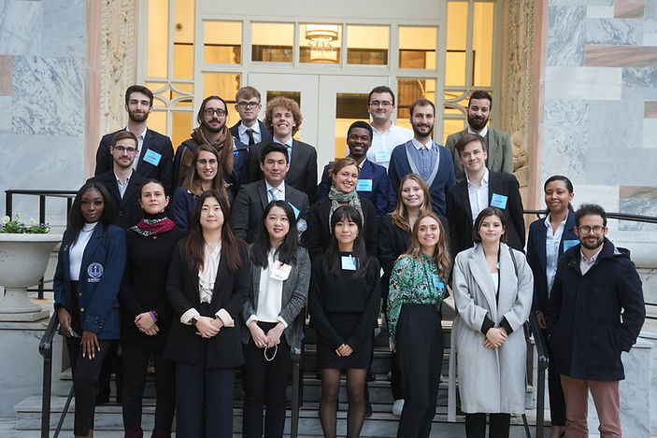
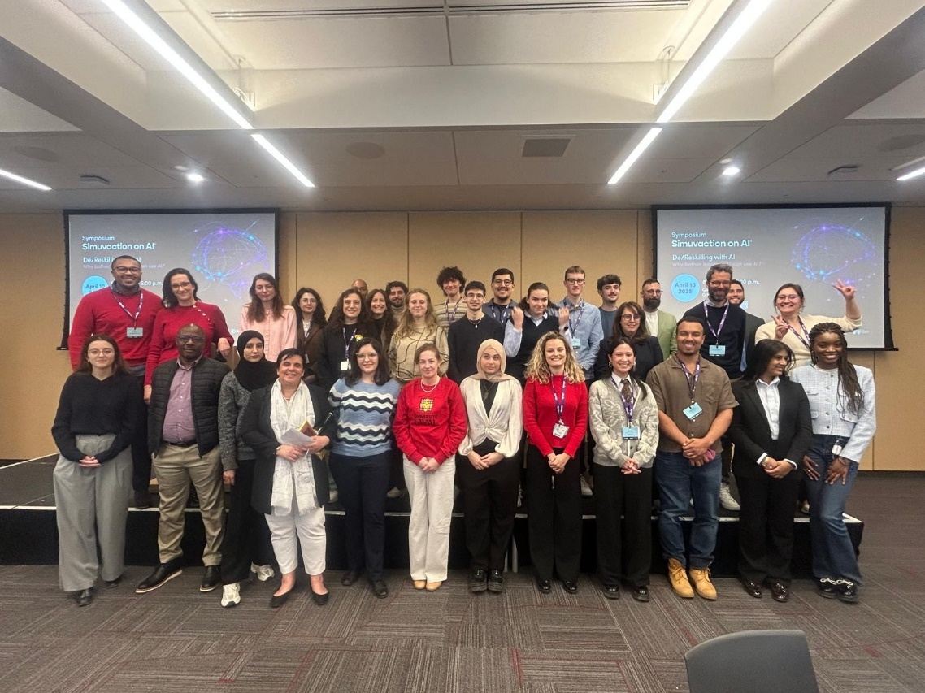
Simuvaction on Artificial Intelligence
Some students of the MSc participated in years 2023, 2024, 2025 in SIMUVACTION on Artificial Intelligence
In year 2026: AI and Eduction on a Global Stage,
in Paris-Versailles (France), March 22-27
SIMUVACTION 2023
SIMUVACTION 2024
Students from across the world write, debate, and vote about global governance of AI
SIMUVACTION 2025

Slide 28
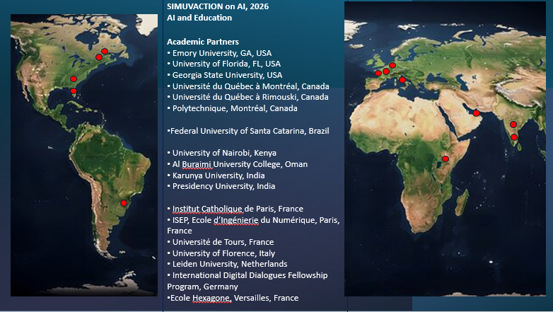
SIMUVACTION on Artificial Intelligence:
List of partners and participants
Notes:
28

Slide 29
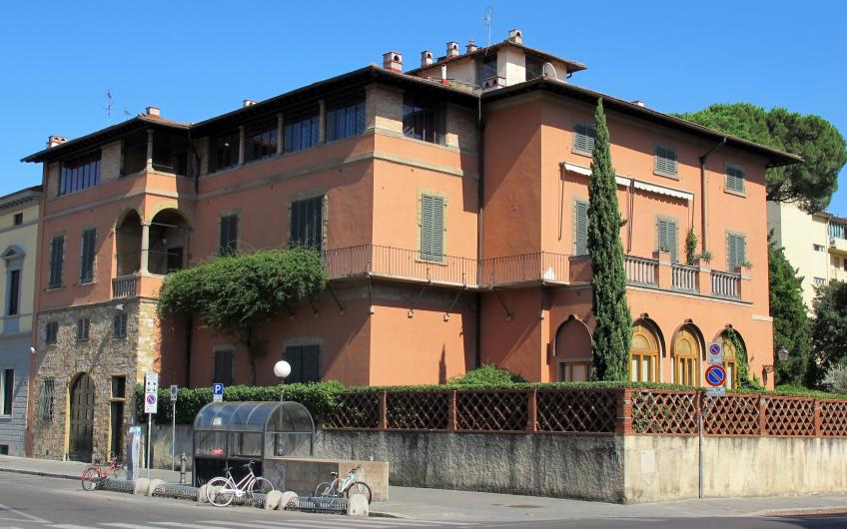
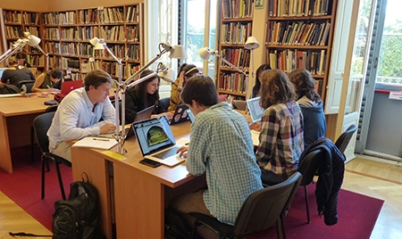
Syracuse University in Florence
Some SUF Students attend
the courses of the MSc
in Economics and Development
at UNIFI
Two courses of the MSc in Economics and Development are given at SUF
International Conflict Transformation
History of Economic Thought
Notes:
29

Slide 30
The Team
Director: Domenico Menicucci (domenico.menicucci@unifi.it)
Admissions:
  Lisa Grazzini (lisa.grazzini@unifi.it) DE
  Annalisa Luporini (annalisa.luporini@unifi.it) E
Study plans:
  Domenico Menicucci (domenico.menicucci@unifi.it) DE
  Annalisa Luporini (annalisa.luporini@unifi.it) E
Traineeship: Filippo Randelli (filippo.randelli@unifi.it)
International Mobility:
  Donato Romano (donato.romano@unifi.it) DE
  Lapo Filistrucchi (lapo.filistrucchi@unifi.it) E
Ph.D. Applications: Antonio Villanacci (antonio.villanacci@unifi.it)
Administration: Barbara Brunelli (english.msc@economia.unifi.it)
Notes:
30

Slide 31
Speeches by 4 students
Sara Dominici
Chiara Musano
Martina Piccardi
Alessandro Guazzini
Notes:
31

Slide 32
Sara Dominici
Graduated in April 2025 (curriculum Development Economics) with a thesis on an index on measuring poverty and deprivation in Tuscany.
Now is research assistant at
Bocconi University (Milan)
working on educational poverty and the economics of education.
Notes:
32

Slide 33
Chiara Musano
Graduated in October 2025 (curriculum Development Economics) with a thesis on Agriculture Productivity in Tanzania.
She is about to start an internship at
FAO (Rome)
The Food and Agriculture Organization is an agency of the United Nations (headquartered in Rome) that leads international efforts to defeat hunger, improve nutrition, ensure food security.
Notes:
33

Slide 34
Martina Piccardi
Graduated in April 2025 (curriculum Economics) with a thesis on integration policies for migrants.
Now is
Junior Researcher and Data Scientist at PPMI
PPMI (https://ppmi.it/) is a Vilnius-based research center mainly working for the European Commission.
Martina works from remote as data analyst and performs theoretical analysis on innovation and sustainability. She is happy with the knowledge of Econometrics she earned in this MSc.
Notes:
34

Slide 35
Alessandro Guazzini
Graduated in October 2025 (curriculum Economics) with a thesis on collusion among firms and shrinkflation.
Now is applying to enter a PhD program in Economics
Notes:
35

